Slide 1
Woodland Public Schools
Facilities and Safety
August 2017 Report

Slide 2
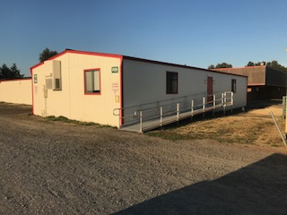
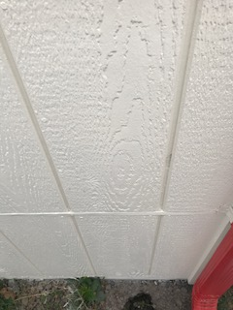
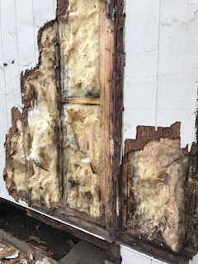
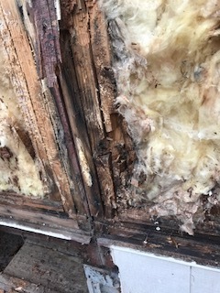
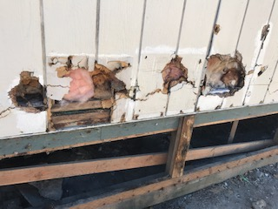
FACILITIES REPORT
Post Rehab
WPS Portable Rehabs One of the biggest transformations of the summer were the portables at WPS. An amazing amount of work was completed on these structures to bring them back to a satisfactory condition. Siding replacements, fresh paint roofing and ramps were just the visible improvements. Behind the scenes work included insulation replacement, pest mitigation and numerous structural beam replacements. In some cases this required temporarily supporting the building on jacks to remove and replace structural beams destroyed from weather or insects. P8/9, the most severely damaged building has a new lease on life and will provide many years service to the district. It is currently housing LCC and a new ECEAP class starts in September.
Post Rehab
Typical portable damage encountered

Slide 3
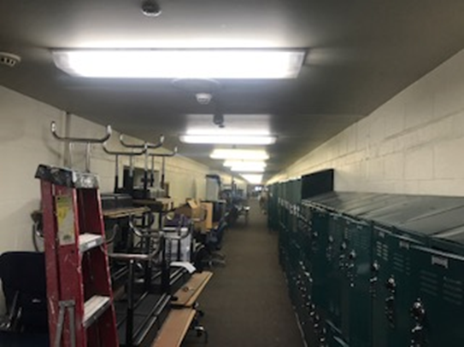
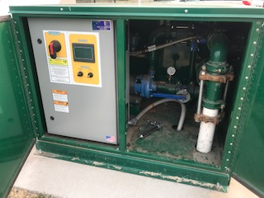
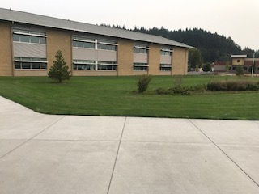
FACILITIES REPORT
LED Lighting LED lights were installed in the Yellow and Green halls of WMS. A total of 360 lamps were replaced (170 fixtures). The ballast were removed and two 14 watt LED lamps were installed on each fixture. The old fixture had two 32 watt lamps and a ballast that draws approximately 10 % of the total applied power. This represents an impressive 60 % reduction in power consumption per fixture. Additional benefits include reduced maintenance cost due to no ballast and an impressive lamp life of 50,000 hours. Additionally the light projected by the LED lamps is focused light with a whiter color, improving the overall appearance, giving the halls a fresh crisper look.
Faulty Frequency Drive
Recovered grounds
High School Irrigation System Since the installation of the sprinkler system at WHS we have struggled to get the system to run as designed. This resulted in loosing and stressing some of the plants and ground cover. Repeated electrical faults in the booster system were found to be the source of the problem. Working with the OEM, we were able to isolate the fault which led to an almost immediate recovery the grounds.
Irrigation pump pic

Slide 4
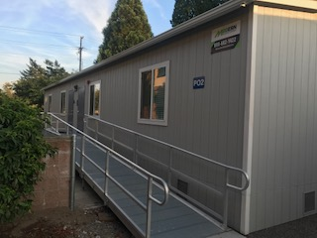
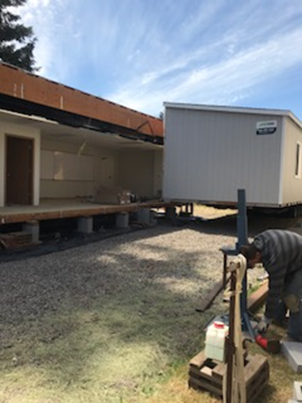
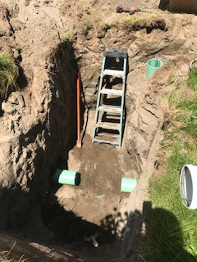
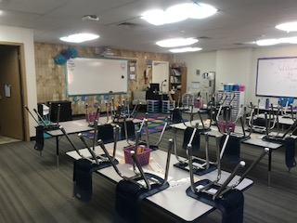
Facilities Report Continued
WIS Portables
The new portables were delivered 26 June, 3 days after school let out. The site was prepped before their arrival for electrical, data, simplex, sewer, water and fire safety. After the buildings were positioned, the following weeks included carpet install, installation life safety devices, furniture, ramps, projectors and final utility terminations. Final occupancy permit was received 7 days prior to kids arriving. The teachers added their personal touches and created fantastic spaces for our kids to thrive.
Portable classrooms PO1/2
Preparing utilities 8 feet down
Portable 4 set up and ready for kids!! Great job Amy!
Positioning the first portable

Slide 5
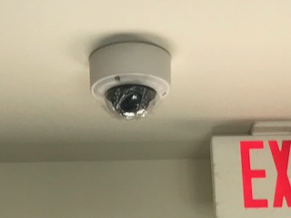
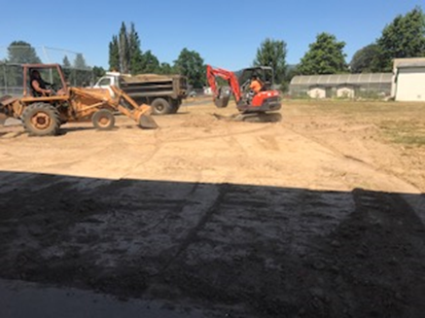
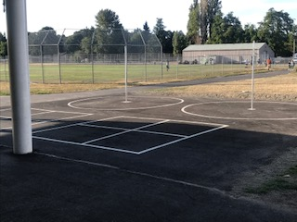
Facilities Report Continued
Security Camera Install Camera systems were installed at WMS and WIS. A total of 79 cameras were installed 53 at WMS ad 26 at WIS. The camera system is on line but requires a software interface to become accessible by admin staff. I expect this to be completed by the time this report is issued. Cameras were placed strategically in each hallway at each school and at exterior locations to enhance safety and security.
New 4 Square and Tetherball Court A 52X52 foot area was excavated and paved near the location of the old IT portable (north of the Yellow Gym covered area) to make way for a new four square and tetherball court. This provides age appropriate play space for the younger students at WMS
Excavation of the area
The finished pad

Slide 6
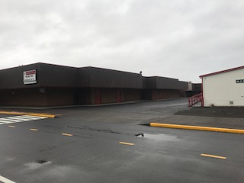
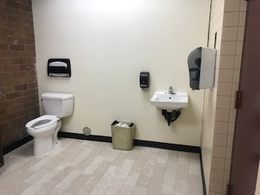
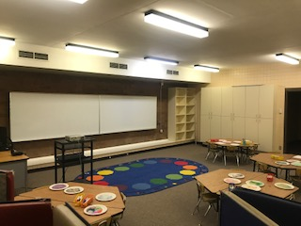
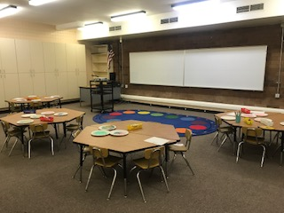
Facilities Report Continued
Painting Primary School
Exterior painting at WPS was finished this summer. This was a 2 year endeavor started last summer and included repairs to the siding. The entire perimeter of the school was painted and trimmed with the school colors.
Locker Room Conversion WPS After two years of work we have managed to convert the two locker rooms at the old Intermediate school (current WPS) to an art and music room. Tons of concrete and tile were excavated to complete this renovation. Additionally a bathroom was installed this summer in the old laundry room to aid in student control.

Slide 7
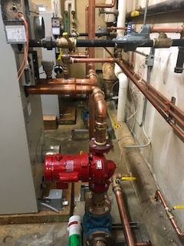
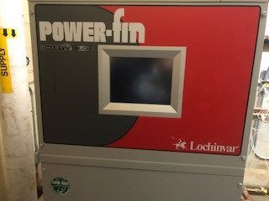
Facilities Report Continued
New Boilers
Two new Lockinvar Power-Fin 900,000 BTU boilers were added to the WMS gym. This included new circulating pumps, piping, exhaust stacks and electrical controls. These units replaced the old boilers that were damaged beyond repair and were installed over 25 years ago.

Slide 8
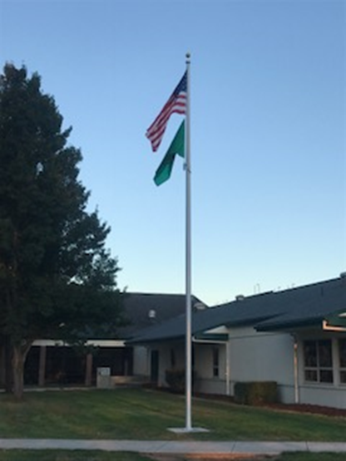
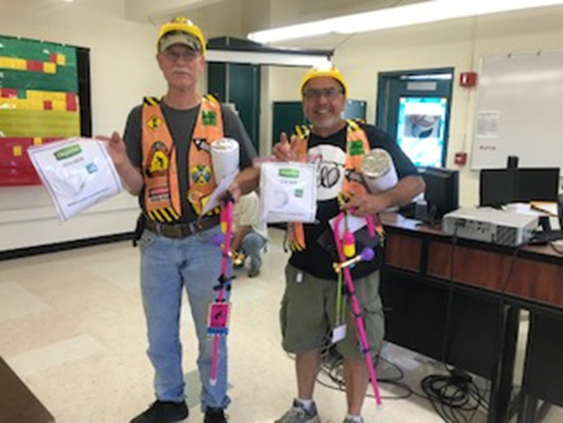
Facilities Report Continued
Two of our employees, Fernando Pavon and Mike Wilson retired this summer and were given an appropriate send off to recognize their combined 25 years of service to the District.
Putting icing on the cake, a new flag pole was appropriately positioned and installed at the WMS office entrance . There are 36 cubic feet of concrete (approximately 4500 pounds) anchoring the pole.

Slide 9
It was a fast and furious (not the movie) summer that yielded numerous positive improvements throughout the District. Many projects were completed with great success but with that being said, we still have a long road in front of us. Not all of the projects scheduled for this summer were completed. We have some significant repairs and improvements that will ebb into the fall before they are complete. The entire Facilities team worked extremely hard over the summer cleaning, painting, making repairs, moving classrooms, deep cleaning classrooms, making repairs to doors, locks, hinges, plumbing, installing whiteboards and projectors, counter top replacements, sheetrock repairs, installing walls, light replacement tile repairs and completing numerous work orders generated during the 16/17 school year. I am hesitant to specifically recognize individuals in the Facilities department because my entire team dedicated their hearts and souls to ensure our schools were ready for kids. With that being said I can not let the over the top work of two of my staff go unrecognized . A special recognition go to Odie (Kevin Larson) and Brad Anderson for the truly superior work they did on the portables and painting of the entire Primary School campus. They are true craftsman in every sense of the word, their work was impeccable, demanding and detailed. Not to mention the fact that it was 90 + degrees weather most of the time they were completing this arduous work. Their superior skills and dedication to our schools is impressive and greatly appreciated. Next months report will contain standard facilities graphs and safety data from September 5th.
Facilities Report Continued

